Slide 1
Travel agent
CAPSTONE PROJECT
Presented By:
Student name : Ayush Kumar Singh
College Name & Department : Siksha ‘O’ Anusandhan University (B.Tech CSE)

Slide 2
OUTLINE
Problem Statement
Technology used
Wow factor
End users
Result
Conclusion
Git-hub Link
Future scope
IBM Certifications

Slide 3
Problem Statement
With the exponential growth of academic publications, technical papers, datasets, and emerging research trends, it has become increasingly challenging for researchers, students, and professionals to keep pace. The traditional approach of manually scanning, evaluating, and synthesizing information across diverse domains is both time-intensive and inefficient.
Proposed Solution: Introducing an AI-powered Research Assistant that leverages Natural Language Processing (NLP) and Retrieval-Augmented Generation (RAG) to streamline the research workflow. This intelligent system will help users efficiently perform literature reviews, generate concise summaries, uncover research gaps, and provide recommendations for relevant papers, datasets, and potential collaborators.

Slide 4
Technology used
IBM cloud lite services
Natural Language Processing (NLP)
Retrieval Augmented Generation (RAG)
IBM Granite model

Slide 5
IBM cloud services used
IBM Cloud Watsonx AI Studio
IBM Cloud Watsonx AI runtime
IBM Cloud Agent Lab
IBM Granite foundation model

Slide 6
Wow factors
Impact and Key Features: The AI Research Agent is designed to greatly enhance research productivity by minimizing the time spent on manual exploration and maximizing the quality of insights drawn from existing literature. It will especially benefit early-career researchers by offering guidance and structure, while also encouraging interdisciplinary work through easier access to relevant knowledge.
Distinct Capabilities Include:
Semantic search across a wide range of scholarly content including papers, journals, and datasets.
Automated summarization of selected academic papers for quick understanding.
Citation and reference tracking to explore the evolution and impact of ideas.
Personalized paper recommendations based on the user’s ongoing research focus.
Keyword and domain-based trend analysis to identify shifts and developments over time.
Collaboration insights, suggesting potential co-researchers or institutions with aligned interests for joint projects.

Slide 7
End users
Academic Researchers
Research Institutions and Universities
Industry R&D Teams
Educators

Slide 8
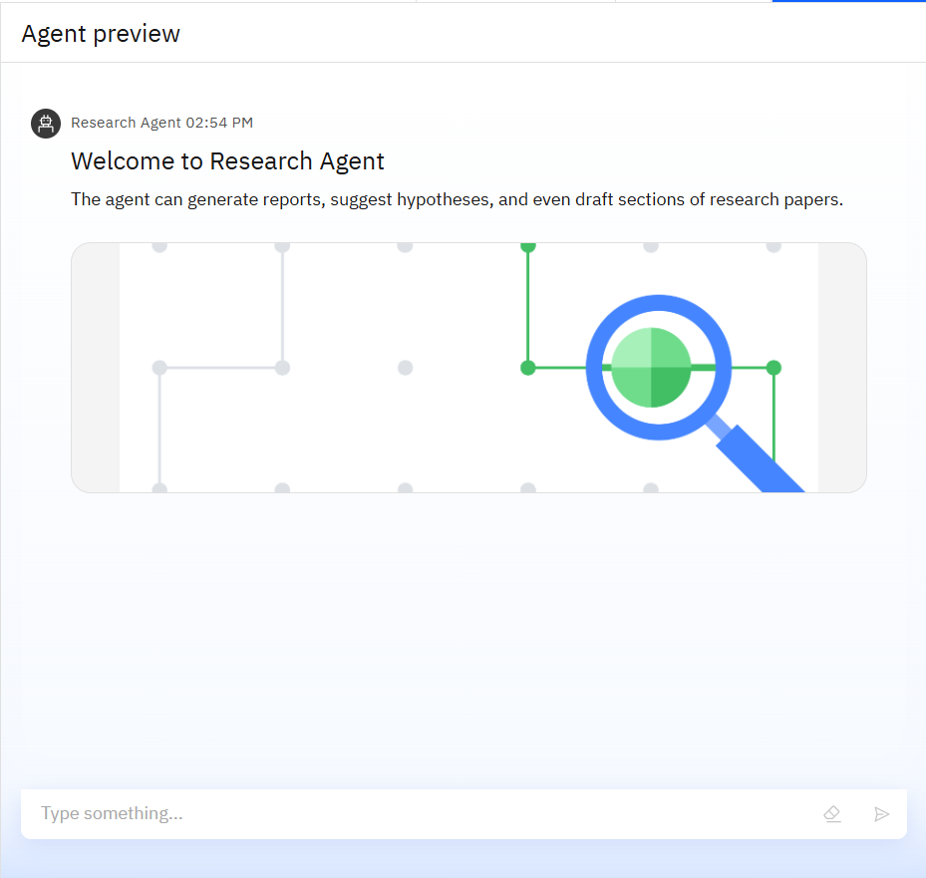
Results

Slide 9
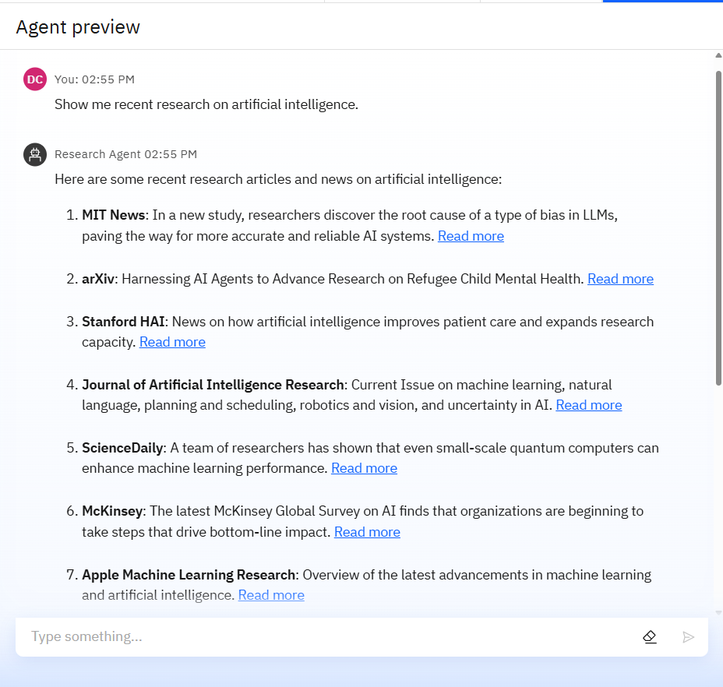
Results

Slide 10
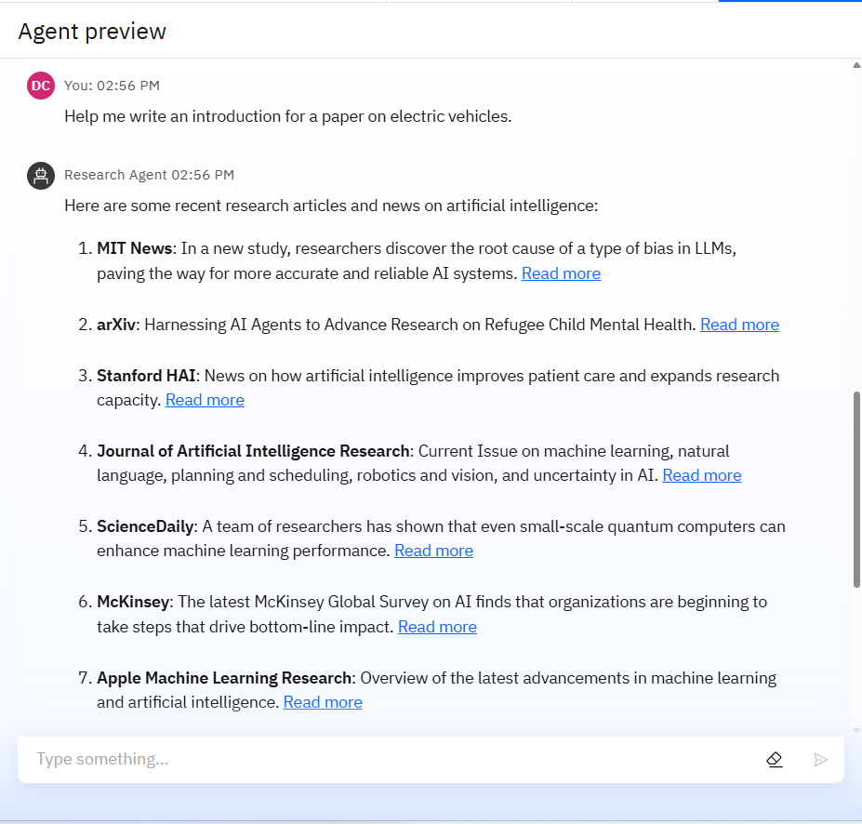
Results

Slide 11
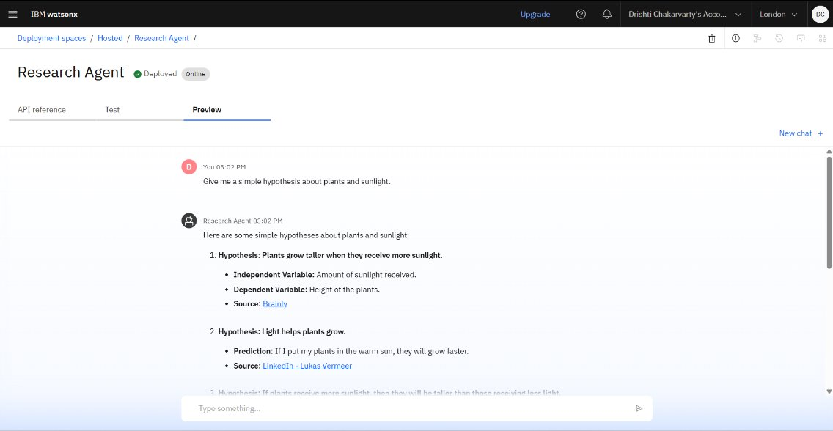
Results
Deployed AI Agent

Slide 12
Conclusion
Additional Capabilities and Benefits of the AI Research Agent:
Automated Report Generation: Produces structured research reports, summaries, and insights tailored to specific queries or domains.
Hypothesis Suggestion: Assists in formulating potential research hypotheses based on existing literature and data trends.
Draft Writing Support: Can help compose preliminary sections of research papers, including literature reviews and methodology drafts.
Repetitive Task Automation: Saves valuable time by handling tasks such as citation formatting, bibliography generation, and data extraction from sources.
Improved Research Efficiency: Streamlines the research workflow, reducing time spent on manual, low-value tasks.
Enhanced Accuracy: Reduces human error in tasks like citation tracking, keyword tagging, and literature organization.
Supports Innovation: Facilitates deeper insights and novel ideas, making it a valuable tool for both academic researchers and industrial R&D teams.

Slide 13
Future scope
Multilingual Research Support
Voice-Activated Research Assistant
Real-Time Collaboration Features
Research Gap and Novel Topic Identification
Integration with Publishing Platforms
AI-Assisted Paper Drafting

Slide 14
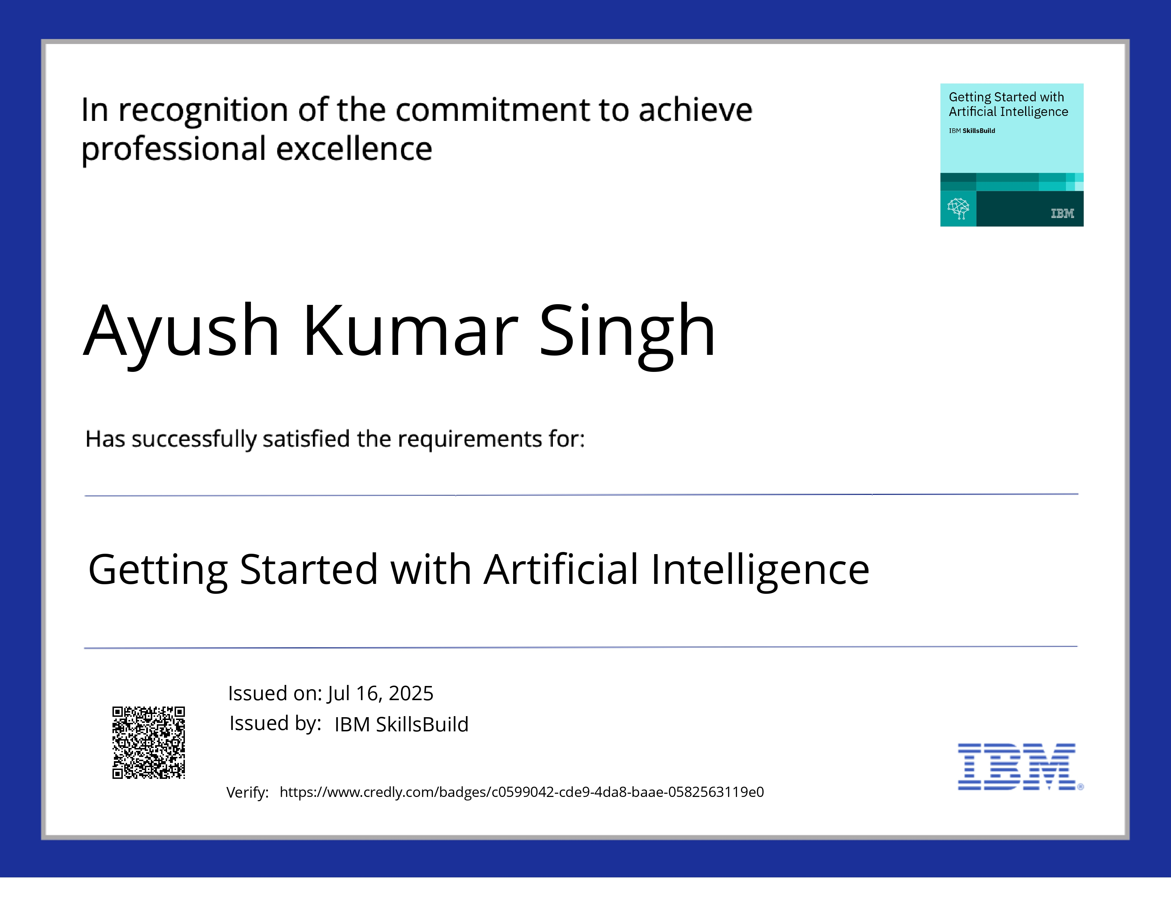
IBM Certifications
Certificate

Slide 15
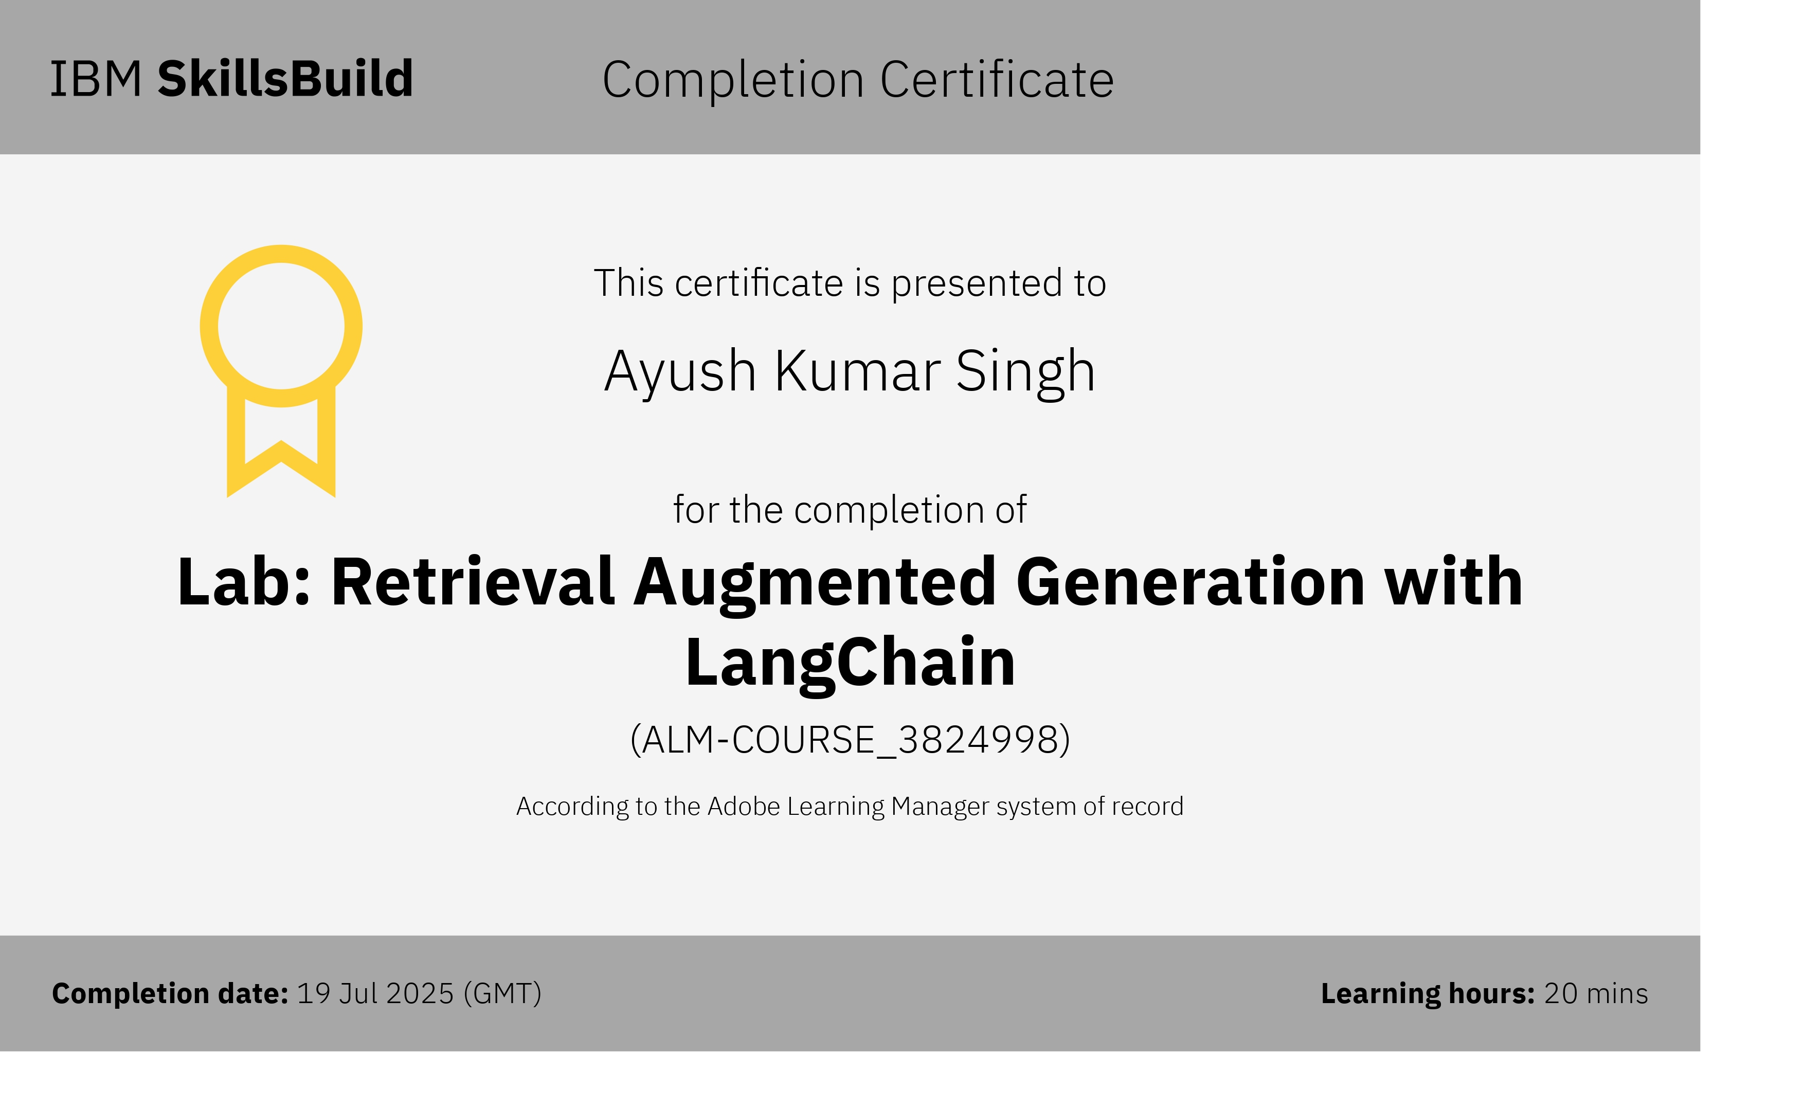
Attach your RAG LAB certificate here

Slide 16
GitHub Link
https://github.com/theayush17/Agent_Phenom

Slide 17
THANK YOU

